Slide 1
Setup Raspberry Pi for ROS

Slide 2
1. Setup SD Card
Insert the card into the computer using the SD card adapter or micro SD slot if available
Open your raspberry pi imager
Write the image file to the SD card. Version 20 must be used for ROS. 22 is only compatible with ROS 2

Slide 3
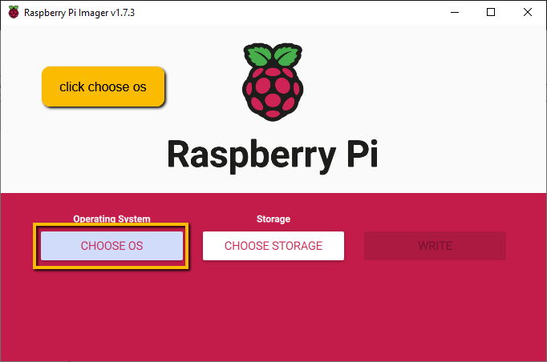
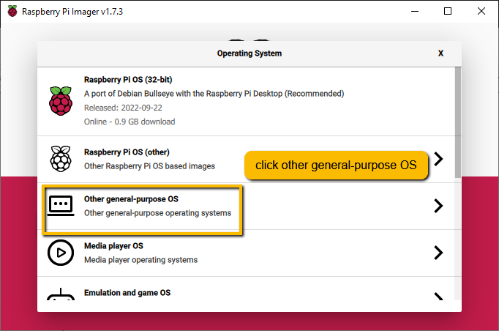
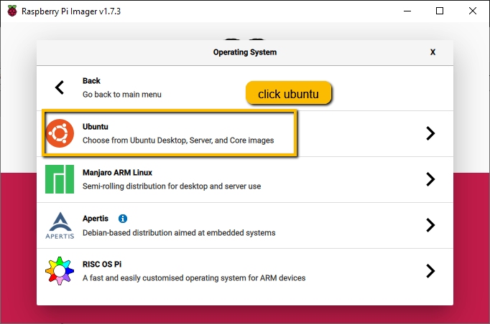
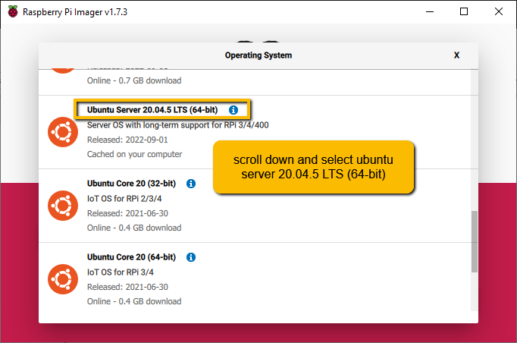

Slide 4
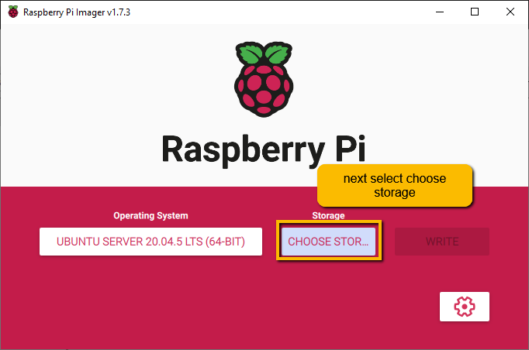
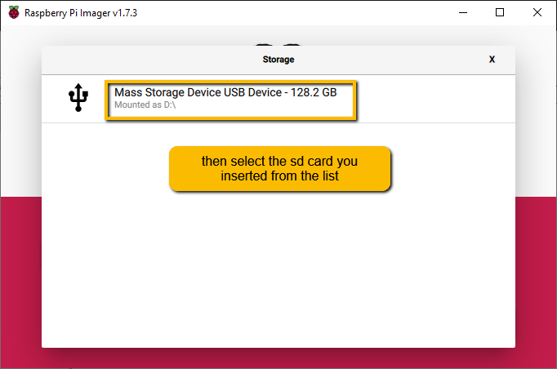

Slide 5
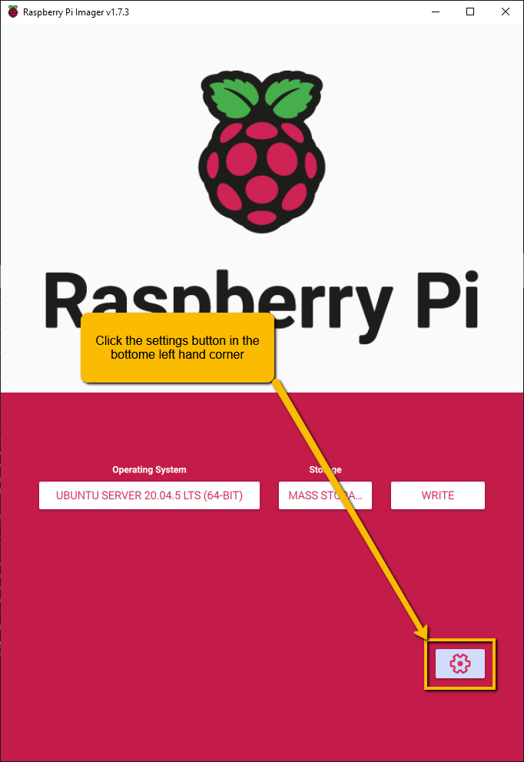
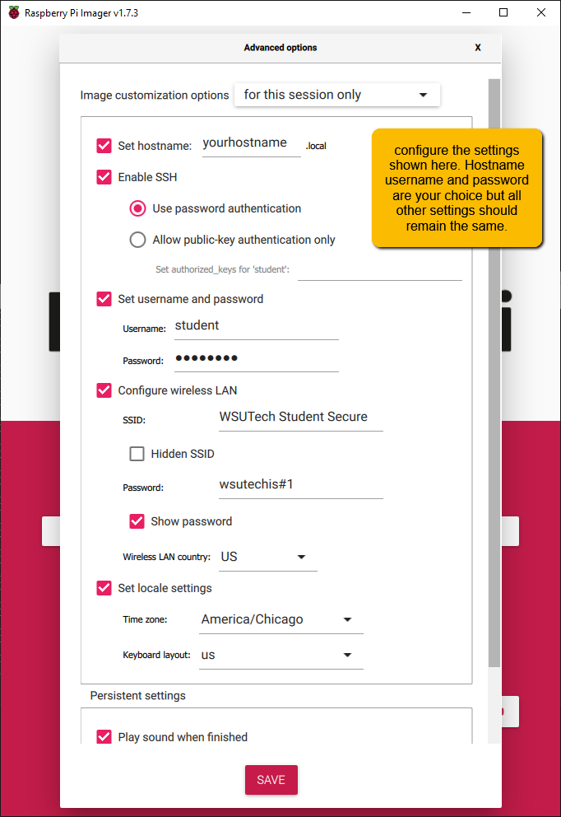

Slide 6
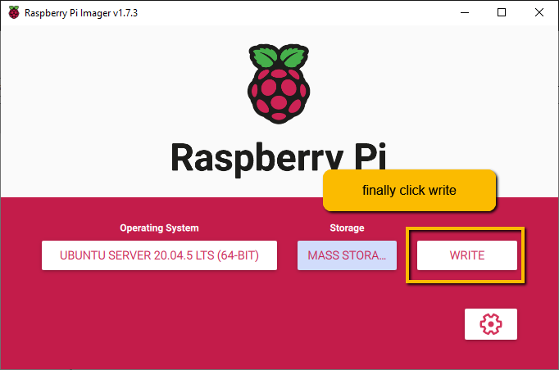
You will get a warning that it is going to erase your sd card. Click yes and it will begin writing the image card to your sd card. Once complete you will recive several warnings saying that your card is not formatted for the computer. This is because it has been reformatted for the raspberry pi. Simply ignore all warnings and remove the SD card from the computer.

Slide 7
2. Setup raspberry pi
Once the rpi boots up you will be prompted to login
Use the login that you created in the settings menu
At this point you can ssh in to continue or you continue with the monitor attached.
To ssh in open command promt on your pc and type
ssh username@hostname
Replace username and hostname with the username and hostname you selected in the settings of the raspberry pi imager
When asked to create an encryption key type yes and hit enter
Once the encryption key is created for the computer you will only need your password to ssh in the future

Slide 8
Update the apt library
sudo apt update
This downloads updates for your apt library
If you are up to date and 0 new package can be installed you do not need the next command
sudo apt upgrade
This installs any updates that need to be applied

Slide 9
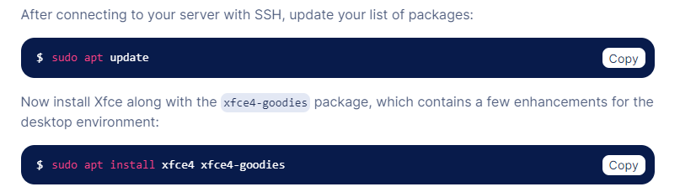
3. Install a desktop environment
You can choose whichever desktop you prefer but I recommend xfce. If you are planning to remote in it will make your life easier.
sudo apt install xfce4 xfce4-goodies
You will be prompted to choose a desktop manager. I usually go with lightdm

Slide 10
Setup remote connection
Install x11vnc
sudo apt install x11vnc
Run x11vnc on your pi
Ctrl-alt-t to open a terminal (not necessary if you ssh in)
Type x11vnc and press enter
Use vnc viewer to establish a remote connection
See following slides for setup
Setup auto login to make remote connection available in headless mode (no monitor)
See following slides for setup

Slide 11
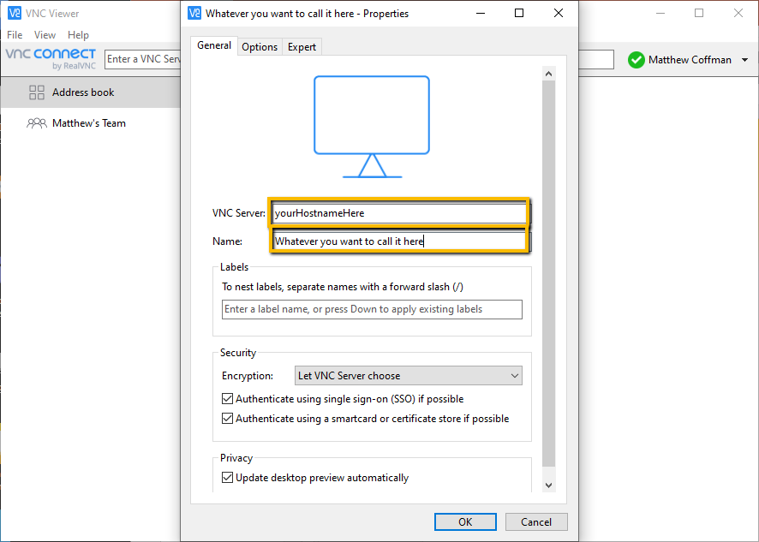
Open Vnc Viewer and create a new connection
Open Vnc Viewer
Go to file -> new connection Or press ctrl+n
Enter your hostname and the name of your computer, then press ok

Slide 12
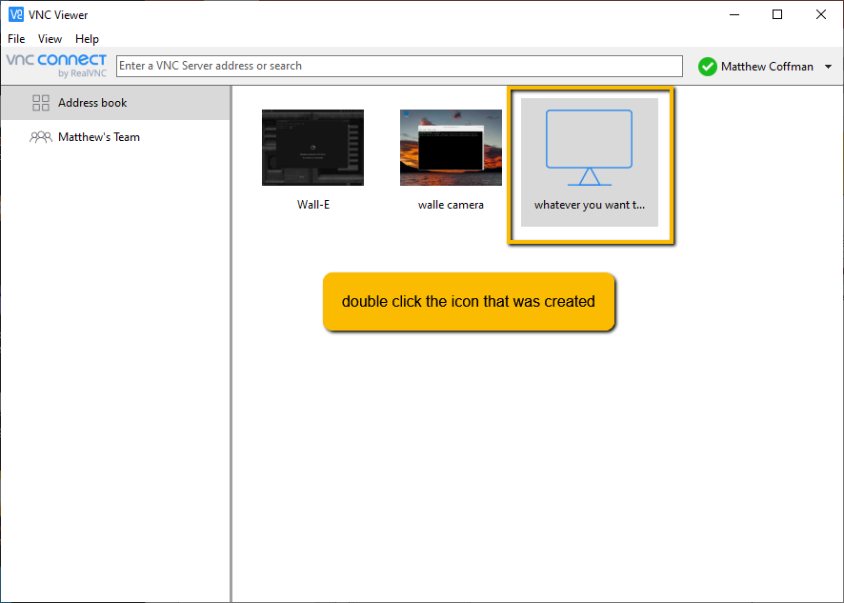

Slide 13
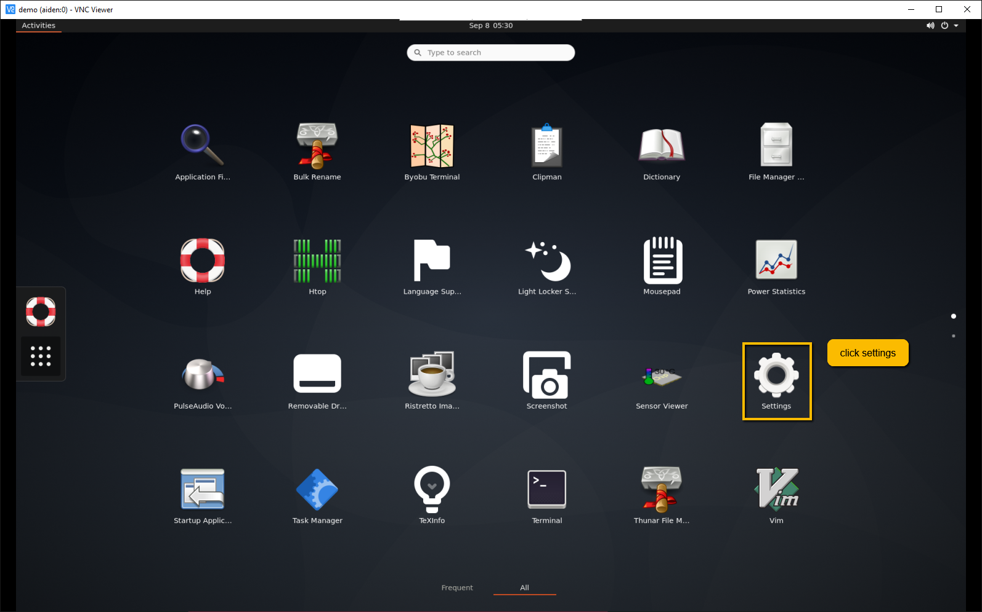
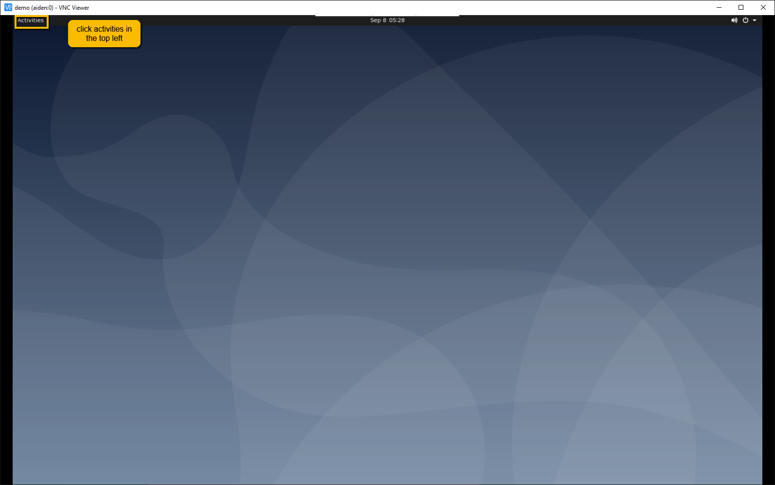
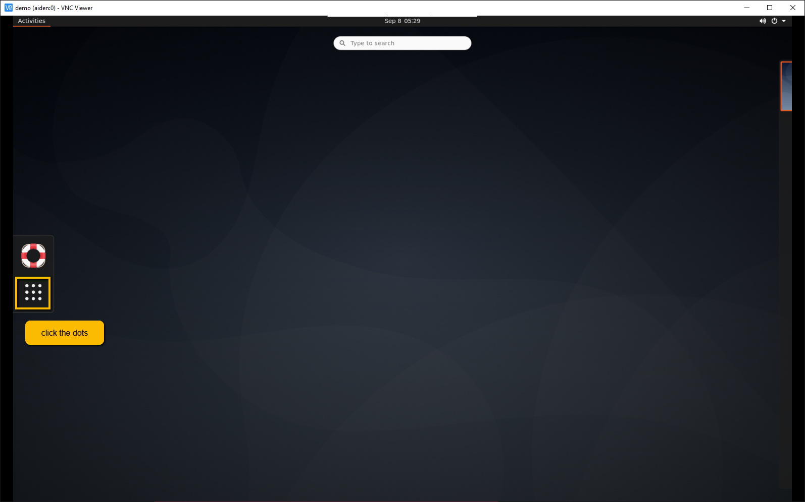
Setup autologin

Slide 14
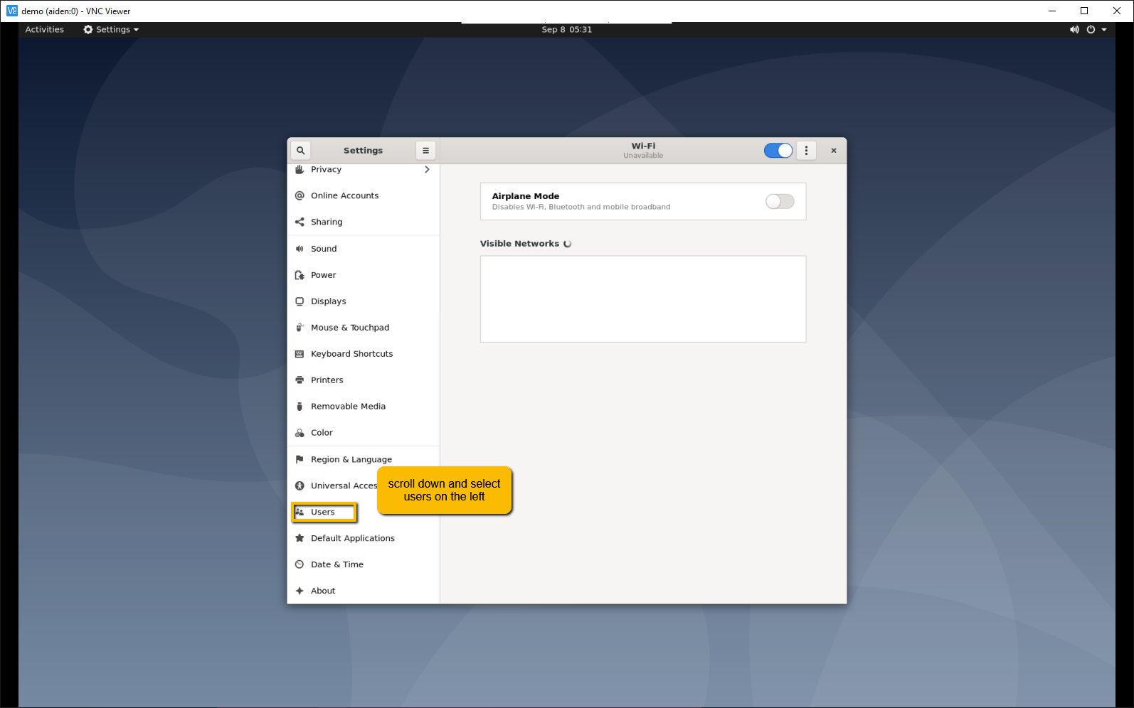

Slide 15
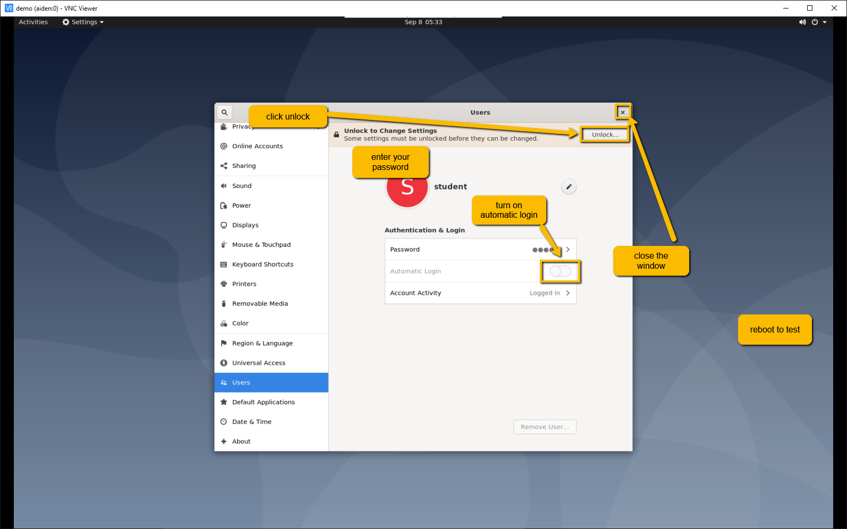

Slide 16
Recommended installs
sudo apt install net-tools
sudo apt install gedit
sudo apt install x11vnc

